Slide 1
TRAPPED INSIDE

Slide 2
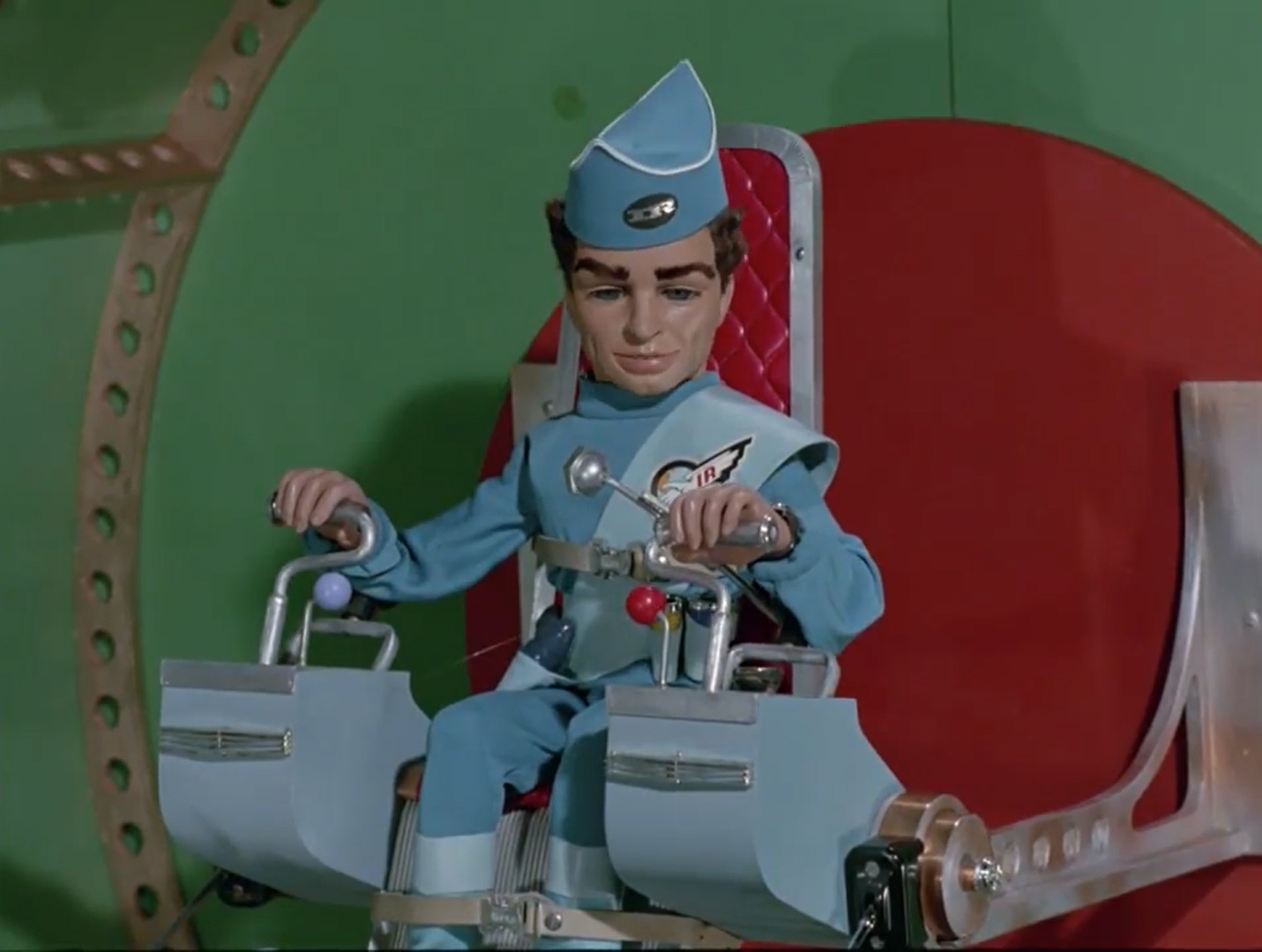
This is International Rescue. We are equipped to help you. Request permission to land.

Slide 3
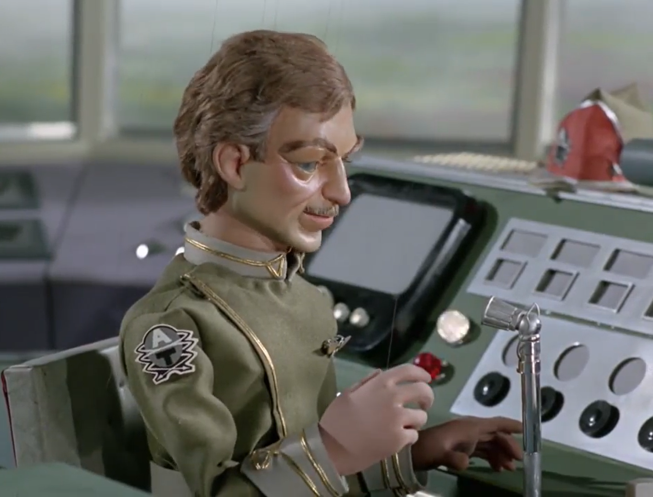
International Rescue? This I must see.
International Rescue, you are cleared to land. Use runway 29.

Slide 4
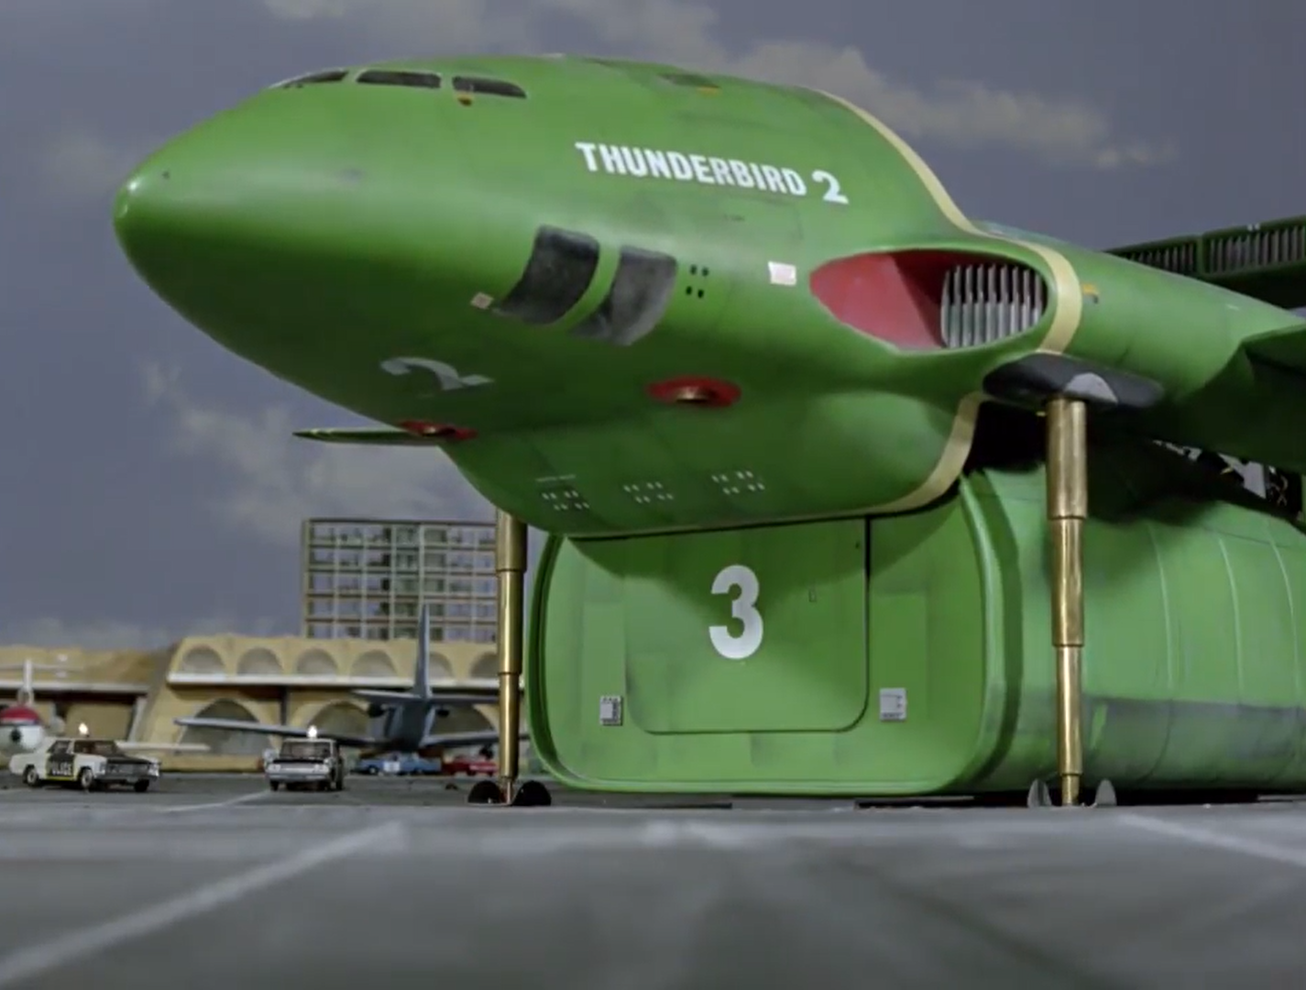

Slide 5
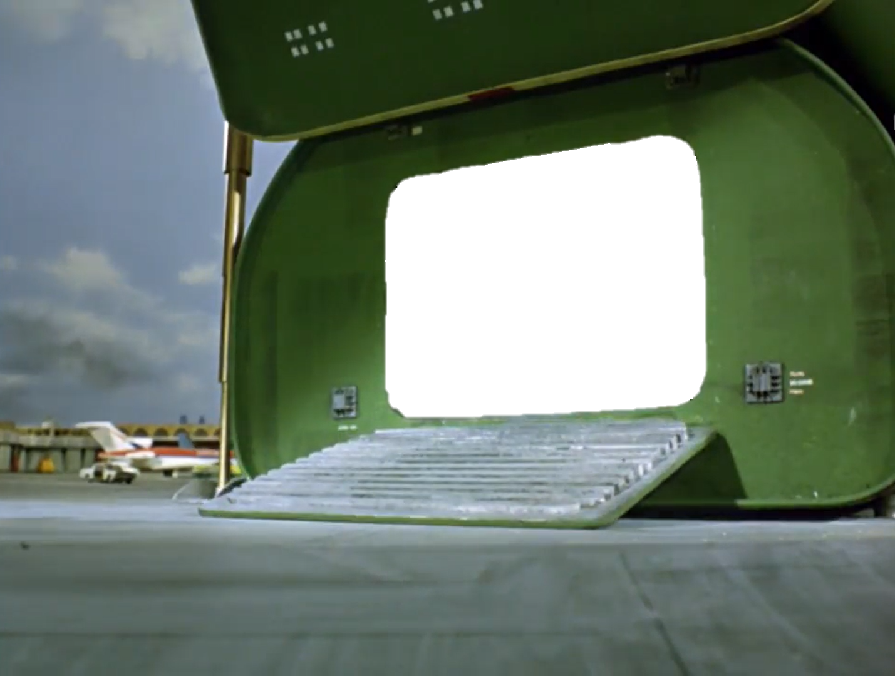

Slide 6
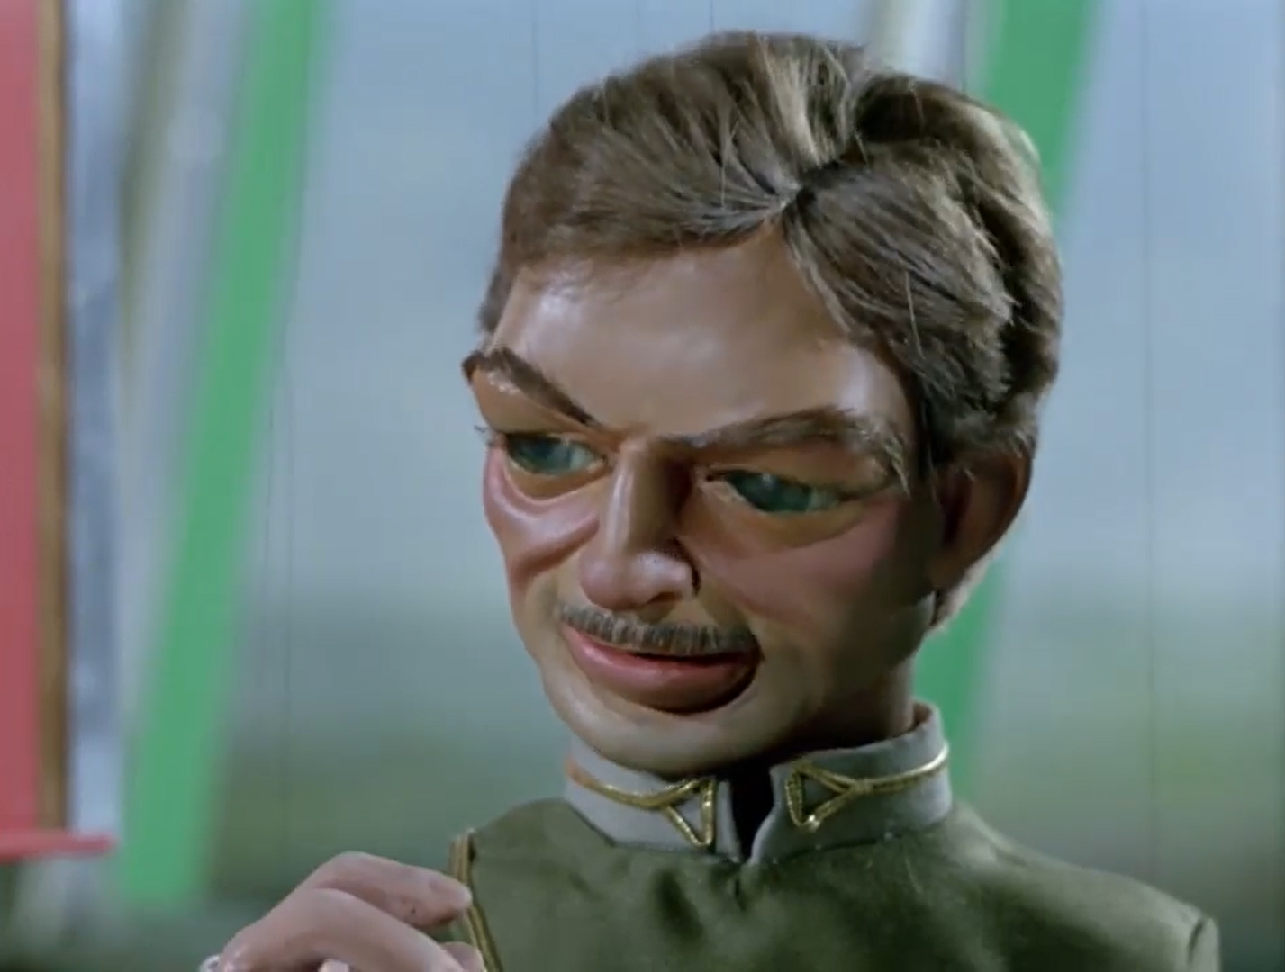
How can we ever thank you?

Slide 7
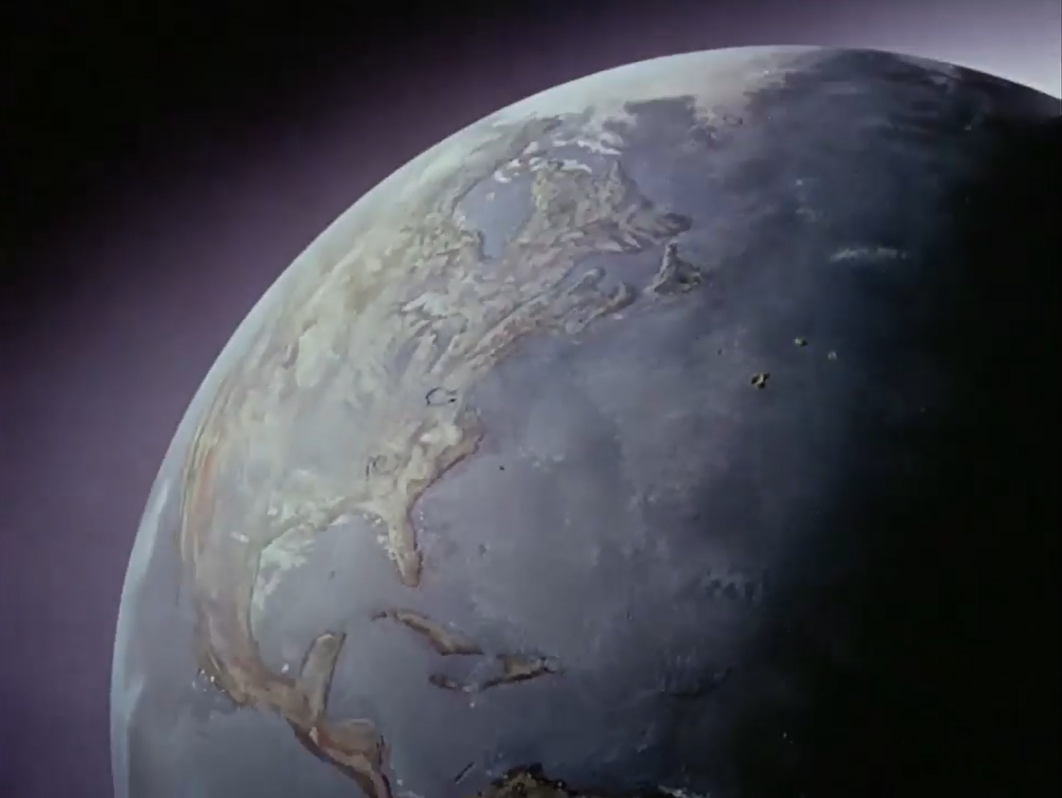
A
J
A
J
PRODUCTION

